Slide 1
Stages of home construction
Create by Momotyuk D.

Slide 2
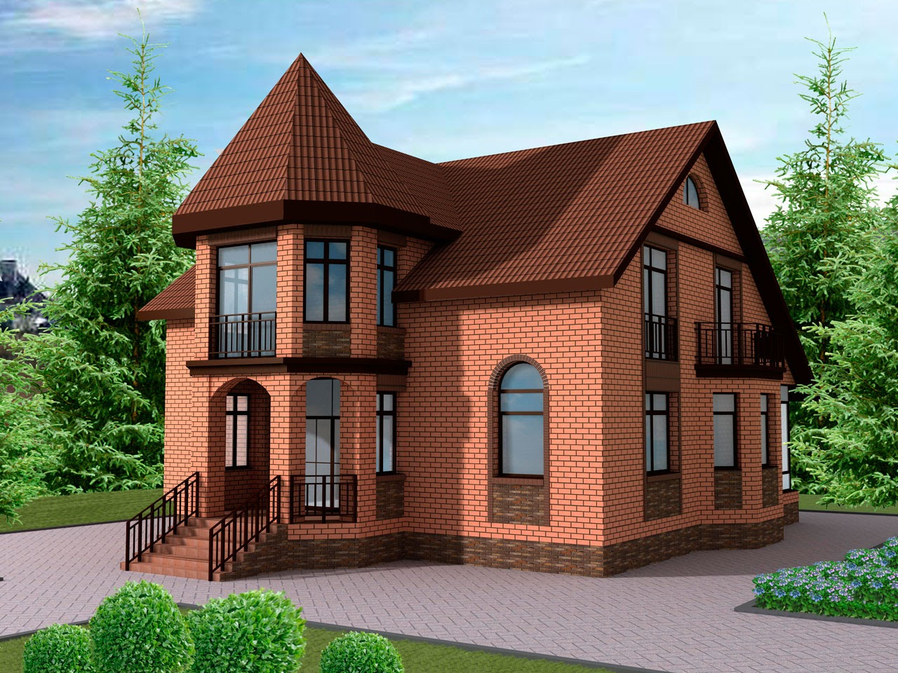
Choice and acquisition of land for construction
When choosing a land plot, you should pay attention to the following points:
environmental situation;
availability of communications:
traffic intersection, availability of access roads;
infrastructure development.

Slide 3
Designing and processing of permits
Stages of construction of a private house include designing. At this stage, the exterior of the house, the internal layout of the house, building materials are selected, as well as a breakdown of the plot with the layout of future buildings. Different project development options are possible:
buy a typical one;
order individual;
come up with your own.
Creating your own project carries great responsibility. If you do not have the construction experience, then you can make many mistakes that will translate into big financial costs in the future. Although an individual project is expensive, it can take into account all the wishes of the client. The typical benefit is that it is created on the basis of finished objects and takes into account all the shortcomings and errors found during construction. It is desirable when designing to make an estimate for each stage of construction. The budget estimates the cost of material, services, mechanical work.

Slide 4
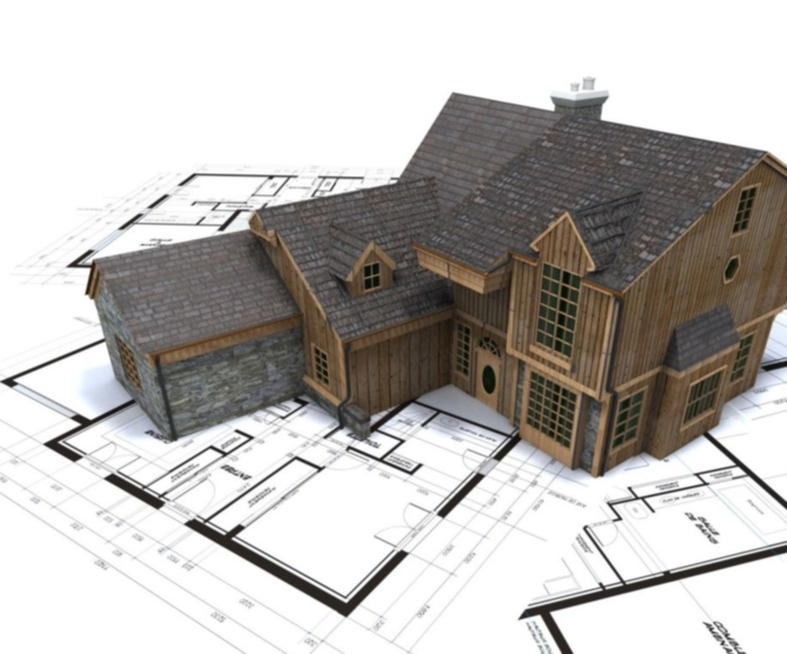
Construction of a cottage
The finished project starts the construction of the house directly. Stages of construction of the house include the breakdown of the plot, land works, the installation of the foundation, the erection of walls, partitions and ceilings, installation of the roof, interior and exterior decoration. Each stage has its own peculiarities.
Land division and land works
The layout of the site should indicate the location of the house, outbuildings, septic tanks, wells. Divide the infield into a residential area, a sitting area, a garden, mark out where the tracks will be held, flower beds, a car park. Our firm can provide assistance with landscape design.
When planning the site should provide communications, device drainage system. Land work consists of digging trenches for laying underground communications for the home and preparing the site for the construction of the cottage. Work is also being done on the installation of septic tank, water intake, drainage and treatment systems.

Slide 5
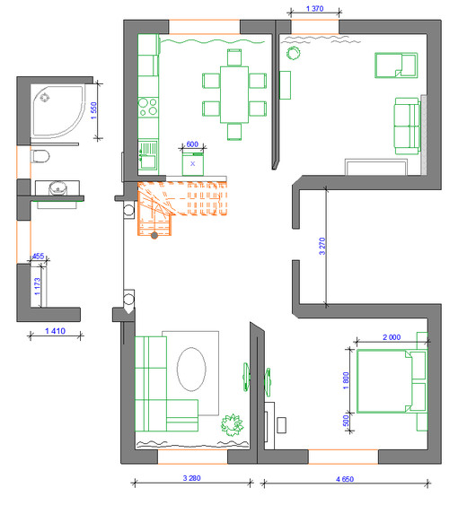
The foundation device
The foundation is selected depending on the soil properties and the future structure. It is the basis of the house, so it must withstand heavy loads. The higher the house, the more powerful the foundation of life should be. It is best to entrust this work to professionals, as any mistake in the construction of the foundation can lead to irreparable consequences.
You can save on the foundation by using aerated concrete, foam concrete or ceramic blocks for the walls. These are lightweight materials and do not require a strong foundation. The concrete foundation must be supported to gain strength and cannot be loaded at this time. In time, it takes up to two months. Before the walls are erected, the waterproofing of the foundation is carried out.

Slide 6
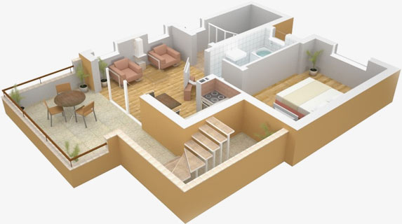
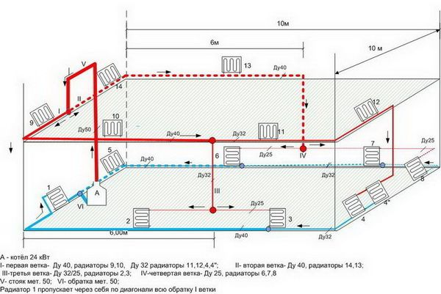
Construction of walls, partitions and ceilings
After the basic works, the gradual construction of a private house involves the erection of walls. For comfortable living in the house, the walls should be strong and warm. It is important to choose the right material. Previously, brick was the most popular material, but nowadays there are new technologies that make it possible to build low-cost energy-efficient homes. During the erection of the walls, thermal, sound and vapor insulation is performed, which improves the performance of the house. Ceilings and interior partitions are installed simultaneously with the walls.

Slide 7
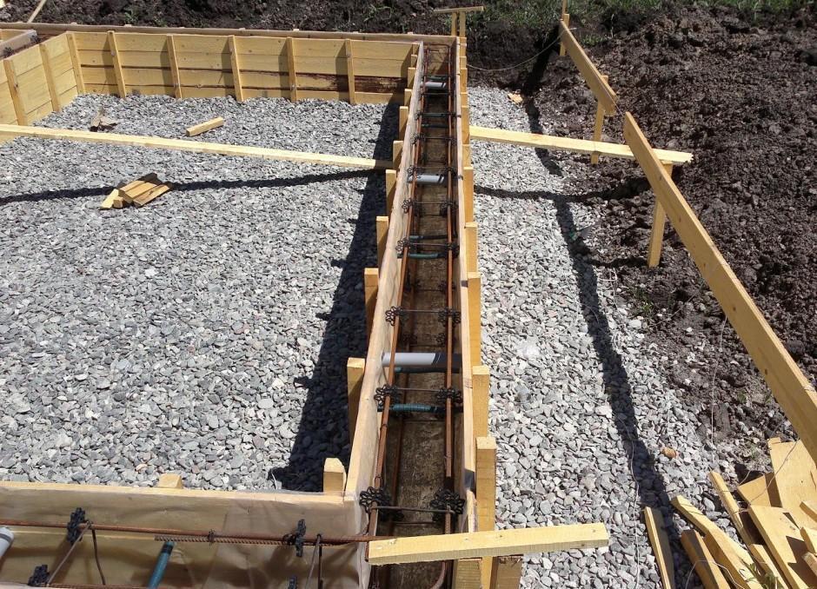
Internal and external finishing
When walls, partitions and ceilings are built, doors and windows are installed. After that, external and internal processing is performed. The construction market is represented by a wide range of finishing materials. There is an opportunity to realize any fantasies and wishes, it all depends on tastes and financial possibilities. It is best to use natural materials. But nowadays, there are a large number of building materials that are indistinguishable from natural ones, and they are cheaper and environmentally friendly.

Slide 8
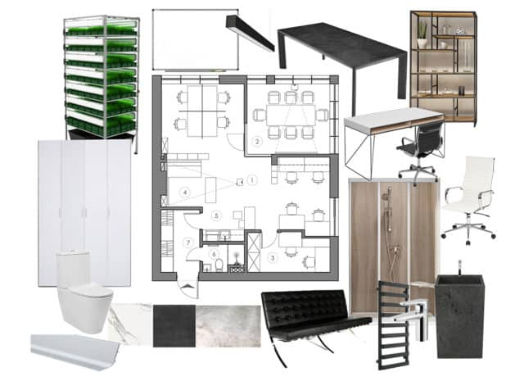
At the final stage, all communications, equipment and equipment, installation of furniture and internal improvement of the house are made. After completion of all work the house is put into operation

Slide 9
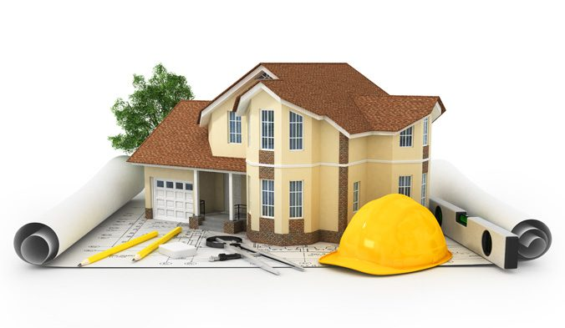
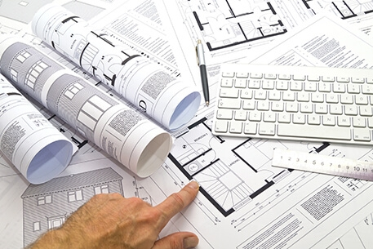
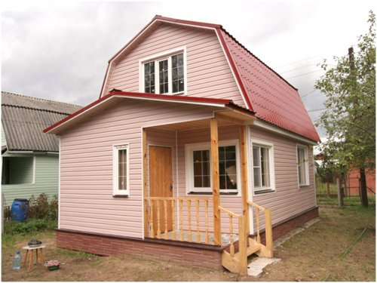
How long can I build a house
This important parameter depends on: the applied construction technology; project complexity; the availability of communications; remoteness of the building from the city; professionalism of the construction team; financial opportunities of the owner. Each of these factors directly affects the overall pace of construction. For example, a wooden house is built much faster than a brick house: the first from 4 to 10 months, and the second from 6 to 15 months.

Slide 10
Thank you!

