Slide 1
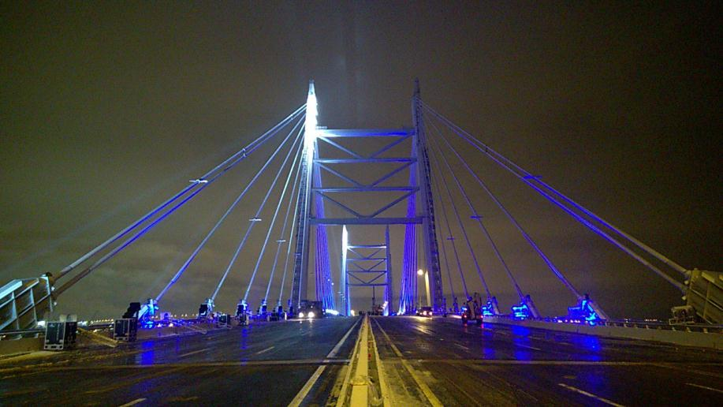
Presentation on the topic: "DESIGN AND CONSTRUCTION OF BRIDGES"

Slide 2
One of the most characteristic aspects of the modern world is the continuous development of the road network. Transport links provide the needs of industry, agriculture and trade, promote rapprochement between countries and peoples.
Railways and roads, oil pipelines and gas pipelines are laid in various geographical and climatic zones, overcome rivers, mountain ranges, taiga and swamps. New roads and pipelines in many cases pass through built-up areas, are built in cities and cross existing railways and roads.
Bridges are one of the oldest types of engineering structures.
In former times, bridges were built like this: they threw logs from shore to shore or laid flat stones across the river.
A BRIDGE is an engineering structure through which people, animals and vehicles cross an obstacle.
Most often, bridges are built across rivers, lakes, canals, mountain gorges, railways and highways.
2

Slide 3
Currently, there are quite a few types of such structures.
Bridges can be classified according to various criteria. Bridges are divided into groups:
1. along the length
2. according to the material from which they are built
3. by appointment
4. by design
5. according to the principle of work
6. by service life
1. Consider the classification of bridges by length. There are four types of bridges in length:
1) small, when the length of the bridge is not more than 25 meters
2) medium, with a bridge length of more than 25 meters, but not more than 100 meters
3) large when the length reaches 500 meters
4) extra-curricular - these are bridges whose length is more than 500 meters
2. Consider the classification of bridges by material. According to the material, there are bridges:
1) stone
2) wooden
3) metal
4) concrete
5) reinforced concrete
6) combined, for example, the span of the bridge is made of steel, and the supports are made of reinforced concrete
Below are examples of bridges made of various materials.
3

Slide 4


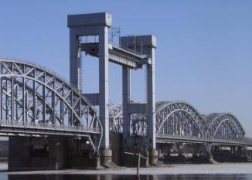
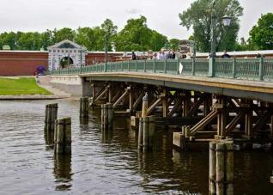
Examples of bridges (material classification)
a stone bridge
reinforced concrete bridge
combined bridge
(steel span, and reinforced concrete supports)
wooden bridge
4

Slide 5
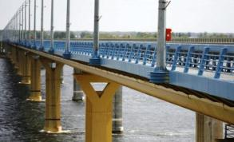
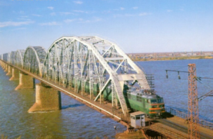
3. Consider the classification of bridges for their intended purpose. By designation, bridges are divided into:
1) pedestrian - designed for pedestrian traffic
2) road - designed for the movement of road transport
3) railway - designed for the movement of trains
4) urban - designed for pedestrians and various vehicles (for example, cars, trams and trolleybuses)
5) viaducts - designed for the movement of various vehicles in both directions
6) flyovers - its task is to “raise” the road above the ground and cross the existing highway or railway lines
7) a viaduct is a bridge over a gorge
The following are examples of such bridges.
Examples of bridges (intended classification)
road bridge
railroad bridge
5

Slide 6

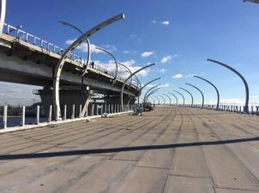
pedestrian bridge
Bridge in Strelna
(Konstantinovsky Palace Presidential Residence)
(Designer CJSC "Institute" Stroyproekt ")
overpass
Western speed diameter. Central plot
(Designer CJSC "Institute" Stroyproekt ")
6

Slide 7
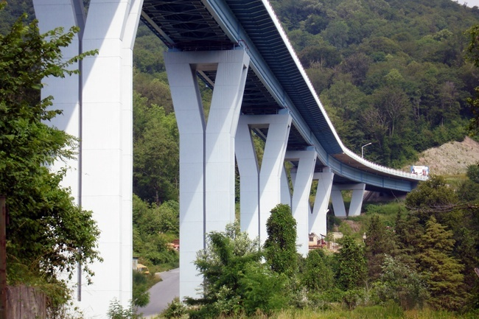
Viaduct
Construction of the M-27 Dzhubga-Sochi Highway to the border with the Republic of Georgia (in Tbilisi, Baku)
(border of the Bakhchisaray district) bypassing the city of Sochi (Designer of ZAO Institut Stroyproekt)
8

Slide 8

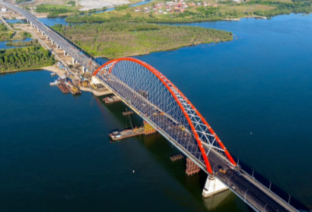
4. Consider the classification of bridges by design. By design, bridges are divided into:
1) beam - in the form of a beam. The simplest girder bridge is a log over a stream
2) arched - in the form of an arch. The first to build arch bridges were the Romans, using bricks or stones for this.
3) suspension - these are bridges that can cover large distances where intermediate supports cannot be used. The flooring of the bridge is suspended on supports using steel cables.
4) cable-stayed
Modern bridges are very different from their first ancestors. Today, these are complex engineering systems with various automatic equipment. That is why there was a classification of bridges according to the principle of work.
The following are examples of such bridges.
Examples of bridges (design classification)
girder bridge
arch bridge
Bridge in Rzhev
Bugrinsky bridge in Novosibirsk
(Designer JSC "Institute" Stroyproekt ")
9

Slide 9

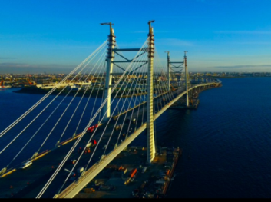
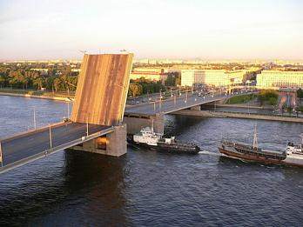
suspension bridge
cable-stayed bridge
5. Consider the classification of bridges according to the principle of operation.
1) ordinary - these are ordinary bridges with a rigid structure.
2) collapsible - these are bridges that can be quickly disassembled and then reassembled.
For example, in the spring when there is a flood, and the water in the river has risen high, the bridge is being dismantled for this time, and then, when the water level in the river has dropped, the bridge is being collected again.
3) adjustable - this is when the span of the bridge is divorced to pass large sea vessels.
The slide on the right shows an example of a drawbridge.
Cable-stayed bridge across the Ship Fairway in St. Petersburg
(Designer JSC "Institute" Stroyproekt ")
drawbridge
10

Slide 10
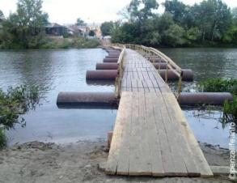


6. Consider the classification of bridges by service life.
1) constant
2) temporary - built for some time.
Temporary bridges are used by the military to transport their equipment to the other side. Such bridges are also called pontoon bridges.
Examples of temporary bridges
temporary bridge
an example of a temporary pontoon bridge that the military is building
11

Slide 11
Bridges are very complex technical structures.
The bridge is designed so that it can withstand floods, gale winds, earthquakes and temperature extremes, as well as vibration from traffic.
The indispensable conditions that any bridge must meet are the highest reliability and durability. The service life of bridges is at least 100 years.
An important role in the design of the bridge is played by its architectural form.
However, returning to the past, when bridges were just starting their long journey, we can say that in those days there was no talk of grace. The need to repeatedly cross water streams or land obstacles forced our ancestors to connect the banks or opposite sides using ordinary logs.
In the era of slave owners, the construction of bridges became more complicated and acquired an organization of a completely different level. The first calculations appeared, which mainly related to the length and height of the future bridge, on the basis of which, materials were prepared for its construction. It is possible that the first bridge designs were completed at that time. The builders of ancient Rome were the first to discover the way to build bridges. First, they constructed the bridge frame, then layered layers of cement and fixing material.
A similar principle of building bridges applies in our time.
12

Slide 12
Bridges around the world are divided into different types, because among them there are suspension, drawbridge, cable-stayed and arch bridges, but each individual case has its own distinctive features.
It is impossible to meet two absolutely identical bridges.
Why are bridges so important? This is largely due to the fact that bridges are able to give the area a more noble and complete look, or merge with natural forms, complementing the natural landscape.
For example, the Northern capital of Russia, St. Petersburg, not without reason is considered a real gem among European cities. Bridges of various shapes and styles give the city a special charm that cannot be found in any other corner of the world.
The following slide shows various architectural solutions for the design of a pedestrian crossing over a road.
13

